Slide 1
Why Imbalanced Data needs extra attention?

Slide 2
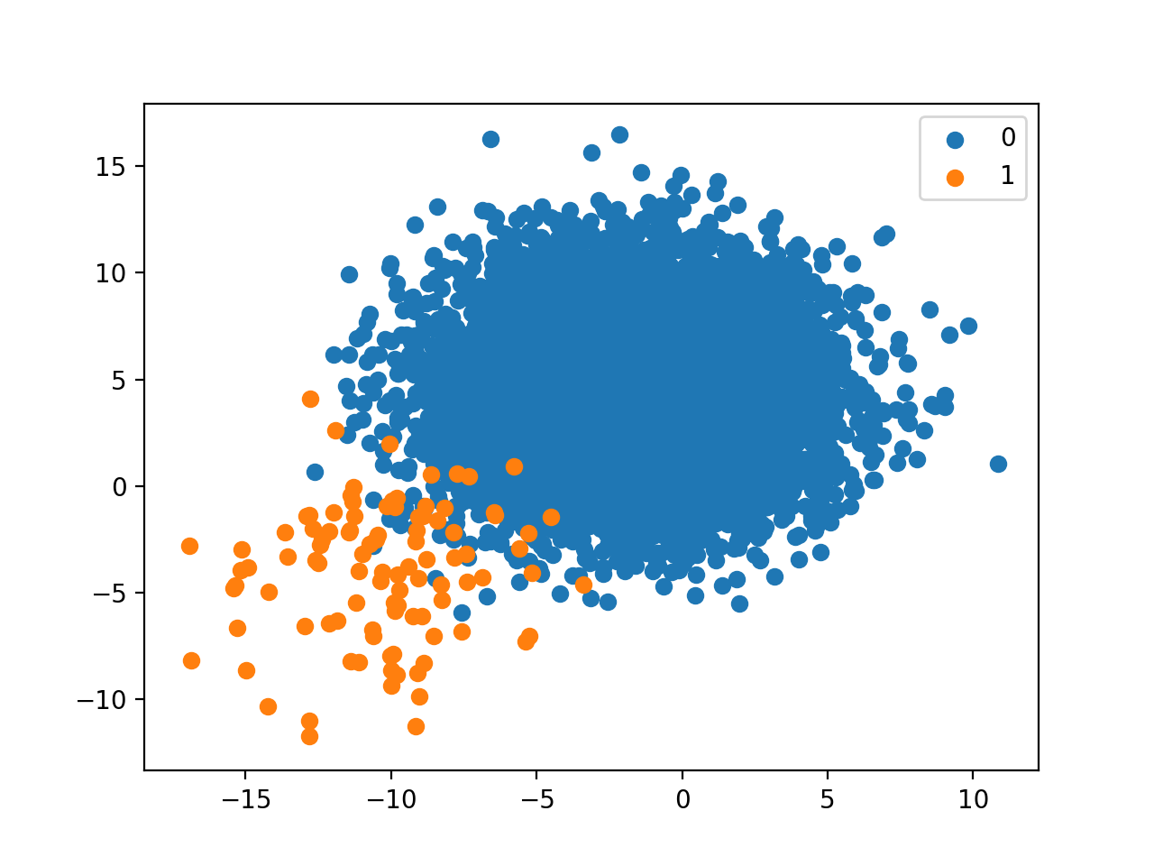
What is an Imbalanced Data?
An Imbalanced data is a data where the number of observations per class is not equally distributed.
Distribution can vary from a slight bias to a severe imbalance.

Slide 3
Imbalance data a serious challenge?
Machine learning algorithms used for classification are designed around the assumption of an equal number of each class.
Minority class is more important and therefore the problem is more sensitive to classification errors for the minority class.

Slide 4
How to Handle Imbalanced Datasets?
Now, we know that Machine Learning Models are not capable of Solving Problems with Imbalanced Data.
But, we have some Special Techniques to solve these Problems
Using Resampling and Ensemble Techniques
Some Special Machine Learning Models specially designed to Handle Imbalanced Datasets.

Slide 5
Using Resampling Techniques to Balance the Imbalanced Data

Slide 6
Resampling technique
Resampling technique is a technique of economically using a data sample to improve the accuracy and quantify the uncertainty of a population parameter.
There are two Popular Resampling techniques
Undersampling
Oversampling

Slide 7
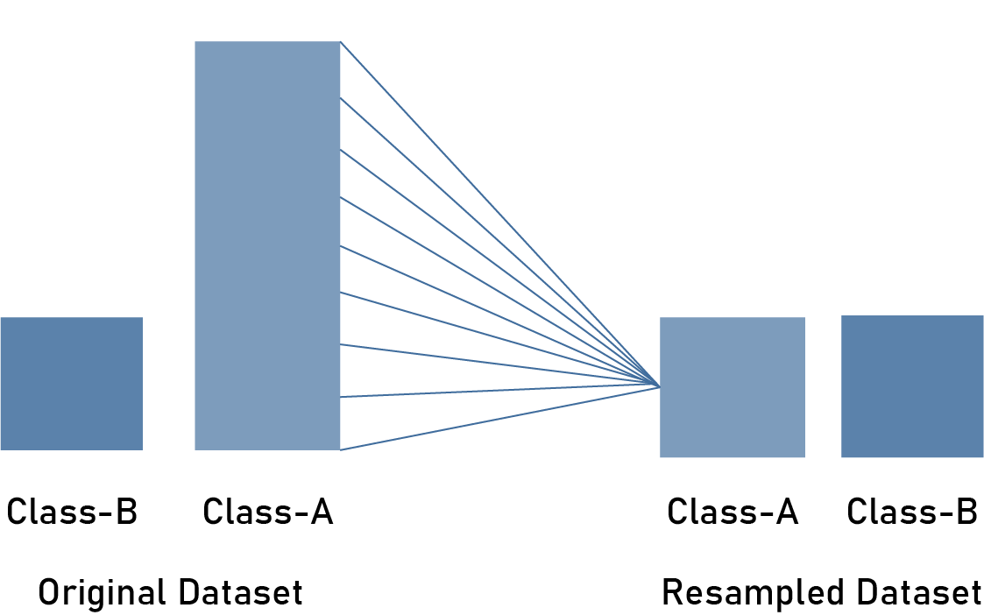
Undersampling
Undersampling balances the dataset by reducing the size of the abundant class.
This method is Prefered when quantity of data is sufficient.

Slide 8
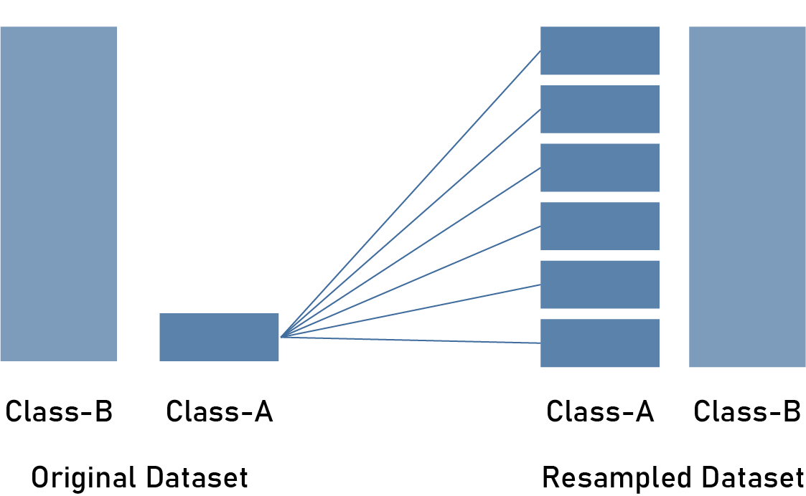
Oversampling
Oversampling balances the dataset by increasing the size of rare samples by using repetition, bootstrapping etc.
This Method is Prefered When the Dataset size is not Huge.

Slide 9
Major Takeaway Points
There is no absolute advantage of one resampling method over another.
Here, is few rules of thumb while using over and under-sampling.
Consider testing under-sampling when you have a lot data.
Consider testing over-sampling when you don’t have a lot of data.

